Slide 1
xpense Trackr
Group 26

Slide 2

Project Description
XpenseTrackr offers a seamless solution for managing employee expenses in organizations. It simplifies the process through user-friendly profiles for both employees and managers.
Employees effortlessly submit expenses by uploading receipts and can conveniently track submission status. Managers receive prompt notifications for new submissions, ensuring efficient review and approval/rejection.
The system facilitates better financial planning by notifying employees when expenses approach 75% of the budget, enabling informed spending decisions. A key feature is systematic expense categorization, simplifying tracking and aiding detailed, insightful reporting.
This approach fosters financial transparency, adherence to company policies, and enhances overall organizational efficiency.

Slide 3
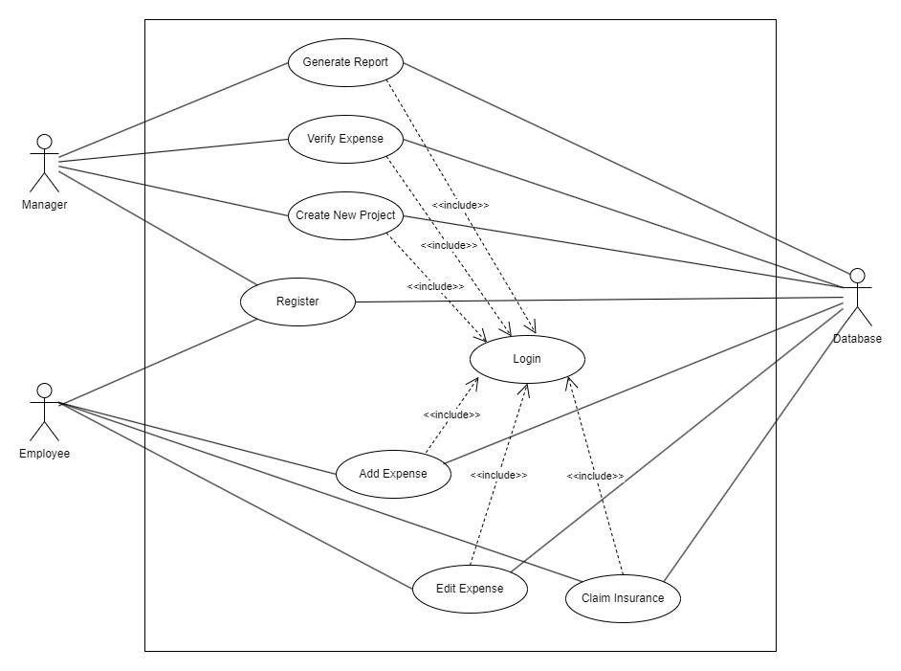
Use Case Diagram

Slide 4
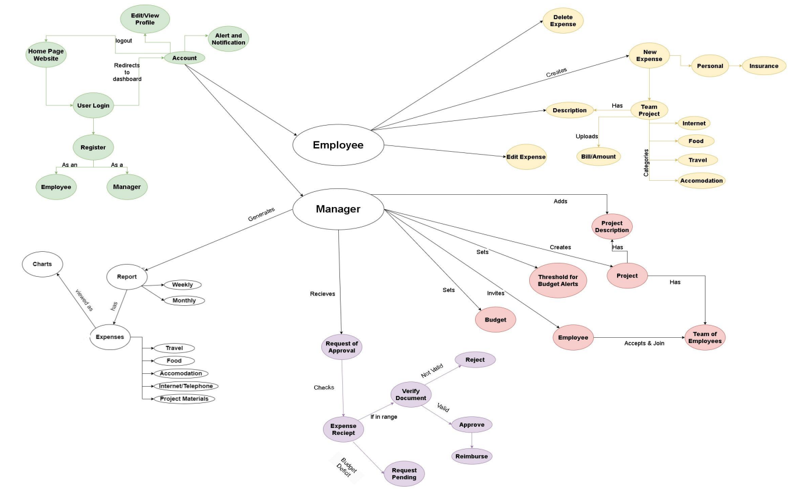
Concept map

Slide 5
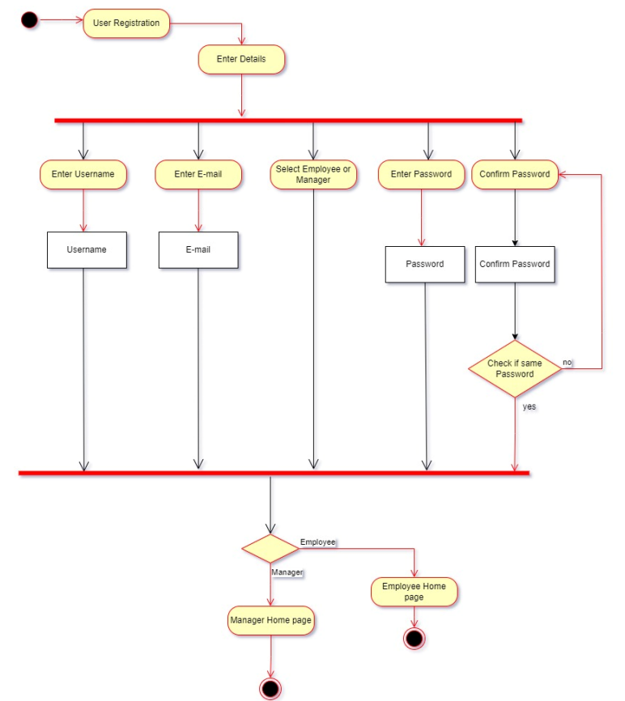
Activity Diagram: Register

Slide 6
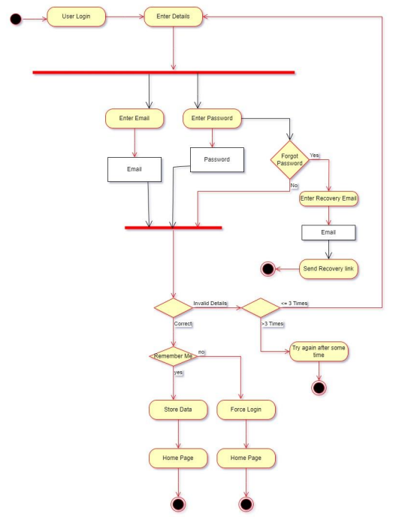
Activity Diagram: Login

Slide 7
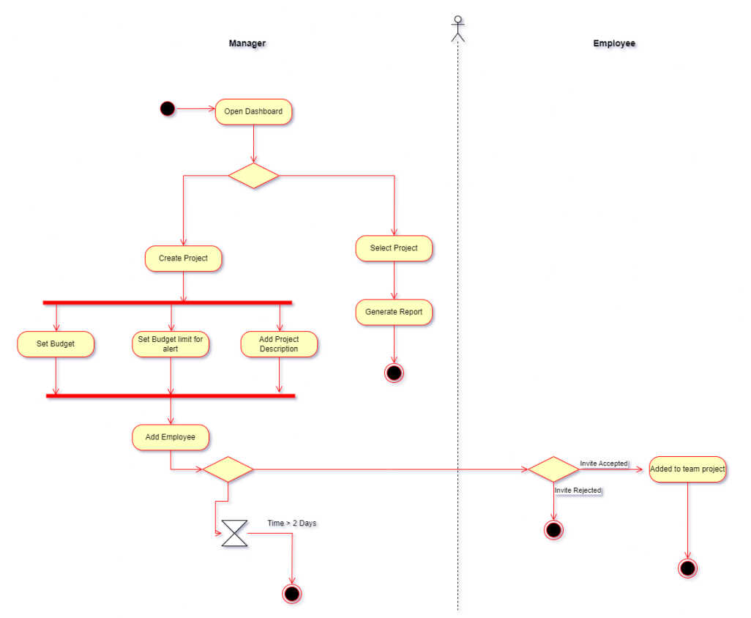
Activity Diagram: create new project

Slide 8
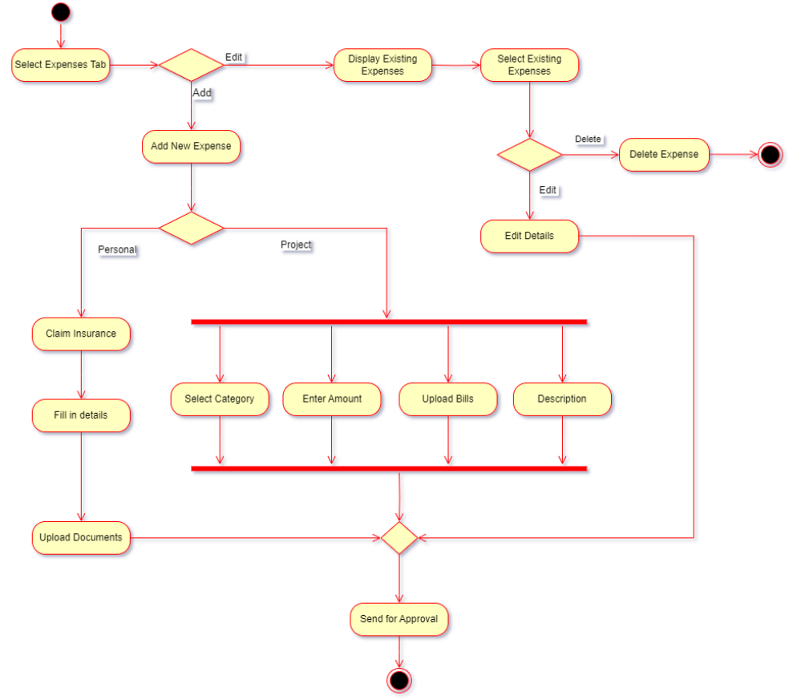
Activity Diagram: add expense

Slide 9
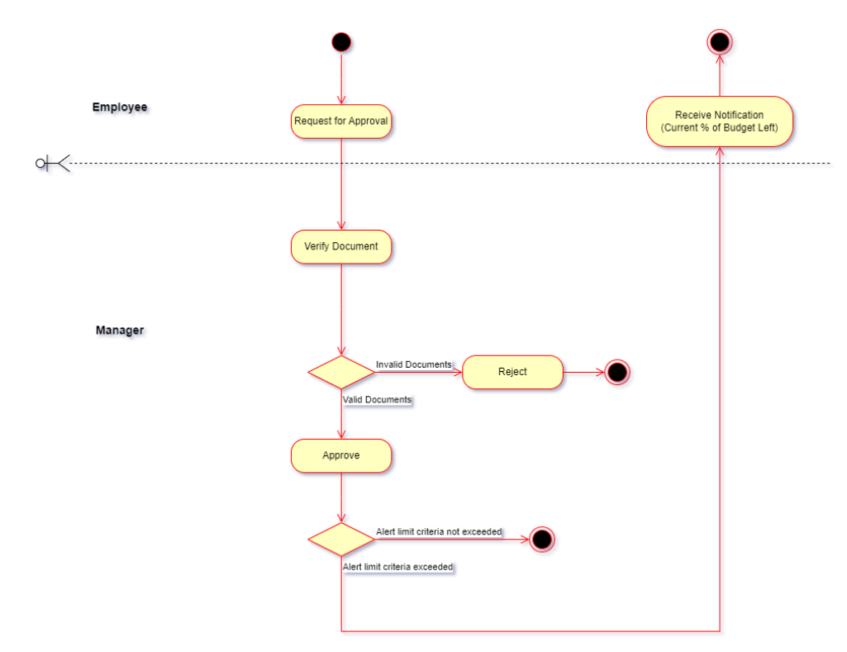
Activity Diagram: verify expense

Slide 10
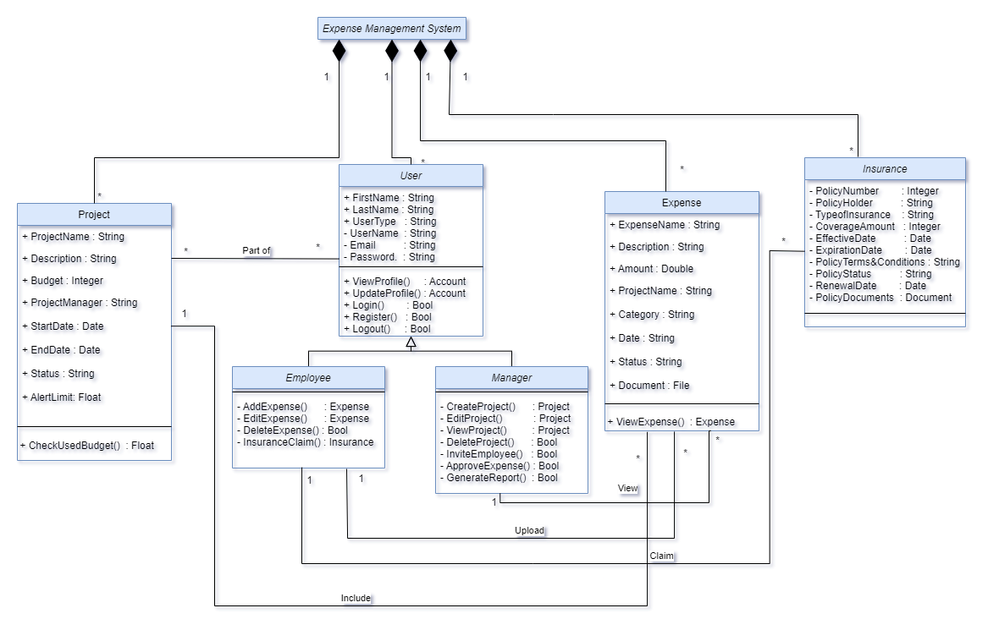
Class Diagram

Slide 11
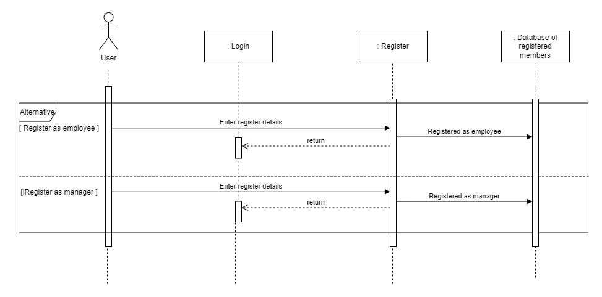
Sequence Diagram: register

Slide 12
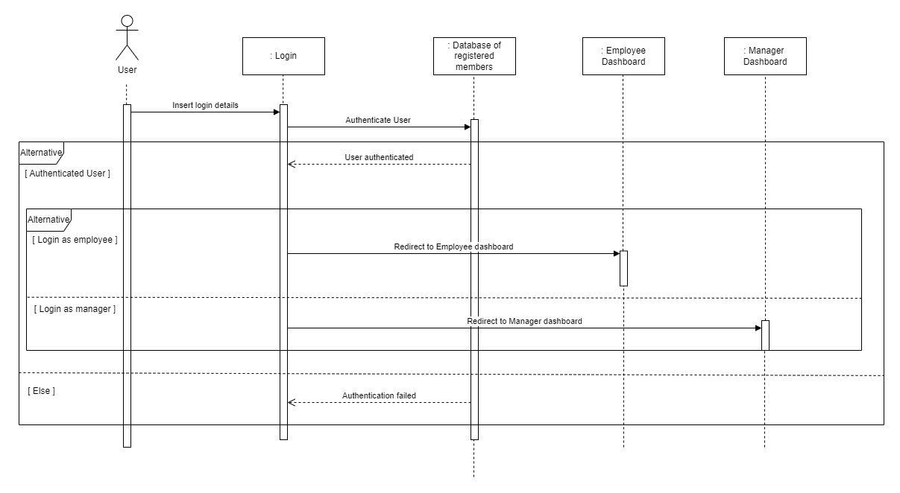
Sequence Diagram: Login

Slide 13
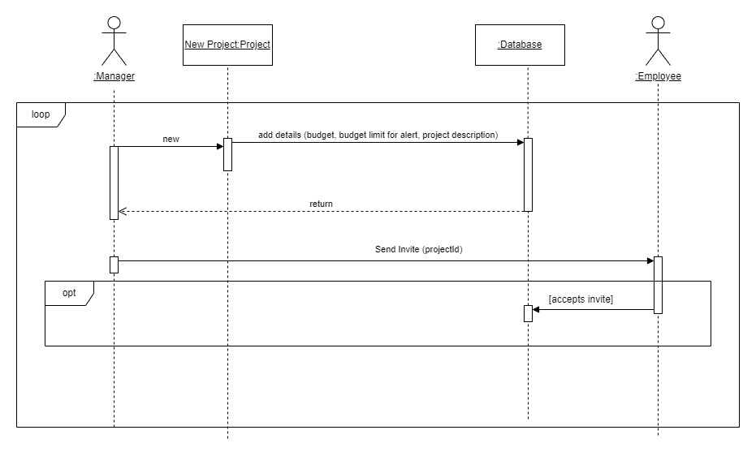
Sequence Diagram: Create project

Slide 14
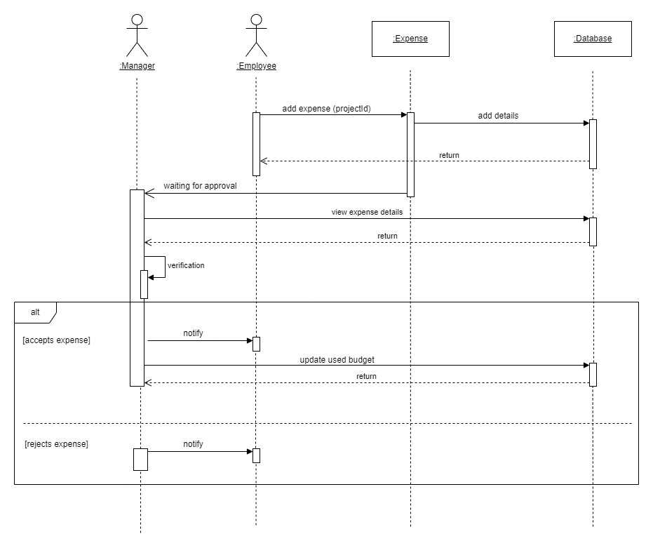
Sequence Diagram: verify expense

Slide 15
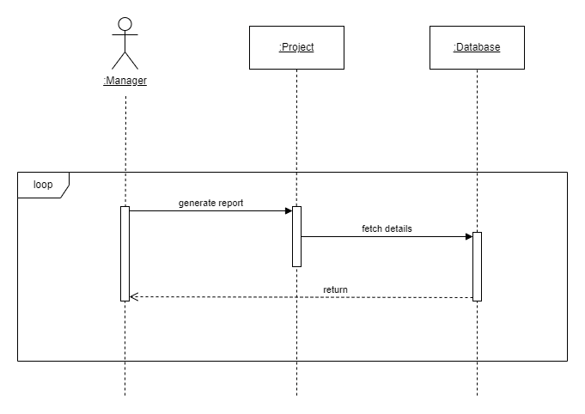
Sequence Diagram: generate report

Slide 16
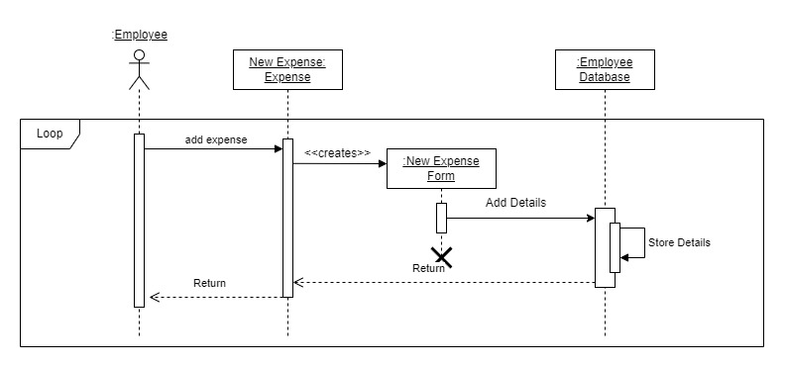
Sequence Diagram: add expense

Slide 17
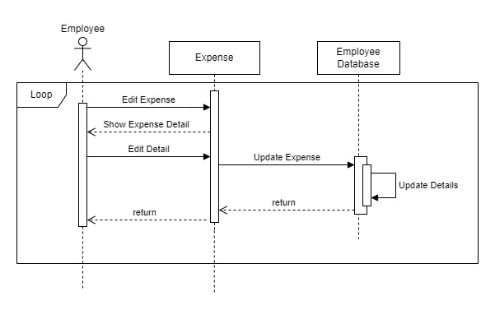
Sequence Diagram: edit expense

Slide 18
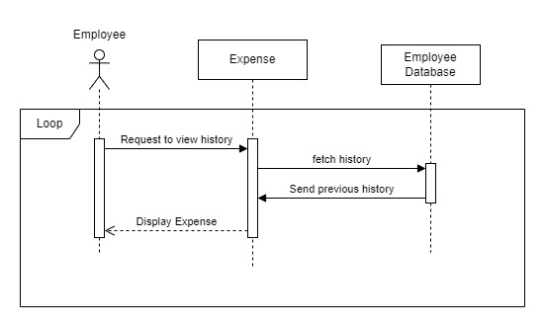
Sequence Diagram: view history

Slide 19
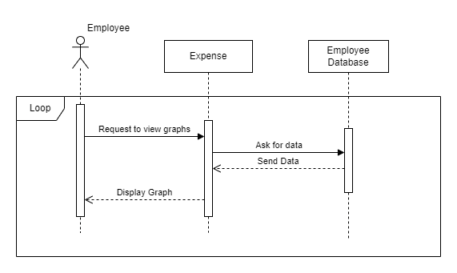
Sequence Diagram: view Statistics

Slide 20
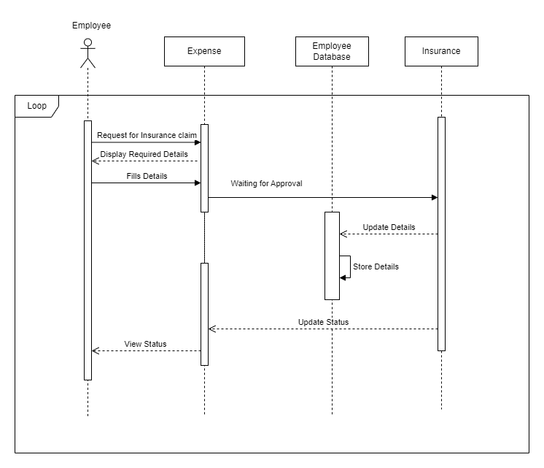
Sequence Diagram: claim insurance

Slide 21
Group members
VEDANT PANDYA (202101063)
JAINIL PATEL (202101416)
HIMANSHU VACHHANI (202101475)
AAYUSH Patel (202101476)
NANCY PATEL (202101491)
KEYUR GOVRANI (202101498)
KASHISH Patel (202101502)
AKHIL PATOLIYA (202101505)
HARDIK MEHTA (202101506)
SAHIL BHADESIYA (202101511)
ISHITA Rathod (202101516)

